Slide 1


Registration now OPEN
Early bird discount extended to October 31st
Call for Papers until October 27th
Call for Maps and Apps until November 10th
http://bit.ly/PHLConf

Slide 2

ArcGIS Open Data Getting Started + Best Practices
Patrick Hammons Esri
phammons@esri.com
Notes:
Welcome
Introductions
Questions:
1. How many are new to ArcGIS Online? 2. How many have used an ArcGIS Open Data site?
3. How many have created an ArcGIS Open Data site?

Slide 3
WiFi Network: NJTPA_Mobile Password: tpa2035!

Slide 4
Follow along! http://bit.ly/esri-njtpa

Slide 5
Agenda
1pm – 3pm
What is Open Data + why it matters
What is ArcGIS Open Data?
Exercise 1: Explore ArcGIS Open Data sites
Data preparation and organization workflows
Exercise 2: Create content for ArcGIS Open Data
Notes:
Briefly cover what is open data, but the primary focus is on ArcGIS Open Data.
Question:
How many of you have created content for ArcGIS Online – services as well as hosted services?
[Use this to determine whether or not exercise 2 needs to be done. Depending on the participants, may be more useful to skip exercise 2 and do exercise 4.]

Slide 6
What is Open Data + why it matters

Slide 7
Open Data principles
Accessible | Discoverable
Explorable | Collaborative
x
Notes:
There are a lot of different views on exactly what constitutes “Open Data”.
Probably the easiest approach is to look at the widely agreed upon core principles of Open Data.
Accessible – needs to include everyone, and not just the 1% (GIS professionals and developers) who understand and know how to work with GIS data.
Accessible generally refers to “machine readable”. So, for example, a table in a PDF file does not qualify as machine readable, while the source table data in a csv file does.

Slide 8
Why does Open Data matter?
transparency
accountability
participation
open data
innovation
economic development
community development
Notes:
Open Data matters for all of these reasons.
Citizens have a right to know how their tax dollars are being spent. But citizens can use the same data to create innovative solutions that government may not have thought of.
Similarly, citizens should be able to find areas of low economic and/or social “performance”, hold government accountable to address these issues, and to provide solutions.
Open Data should be more than a “checkbox”. Open Data can only achieve its potential if there is a commitment to providing access to quality, well prepared data.

Slide 9
What is ArcGIS Open Data?
Notes:
https://hub.arcgis.com/pages/open-data
Walk through open data
Interface
Features
Walk through:
Hub

Slide 10
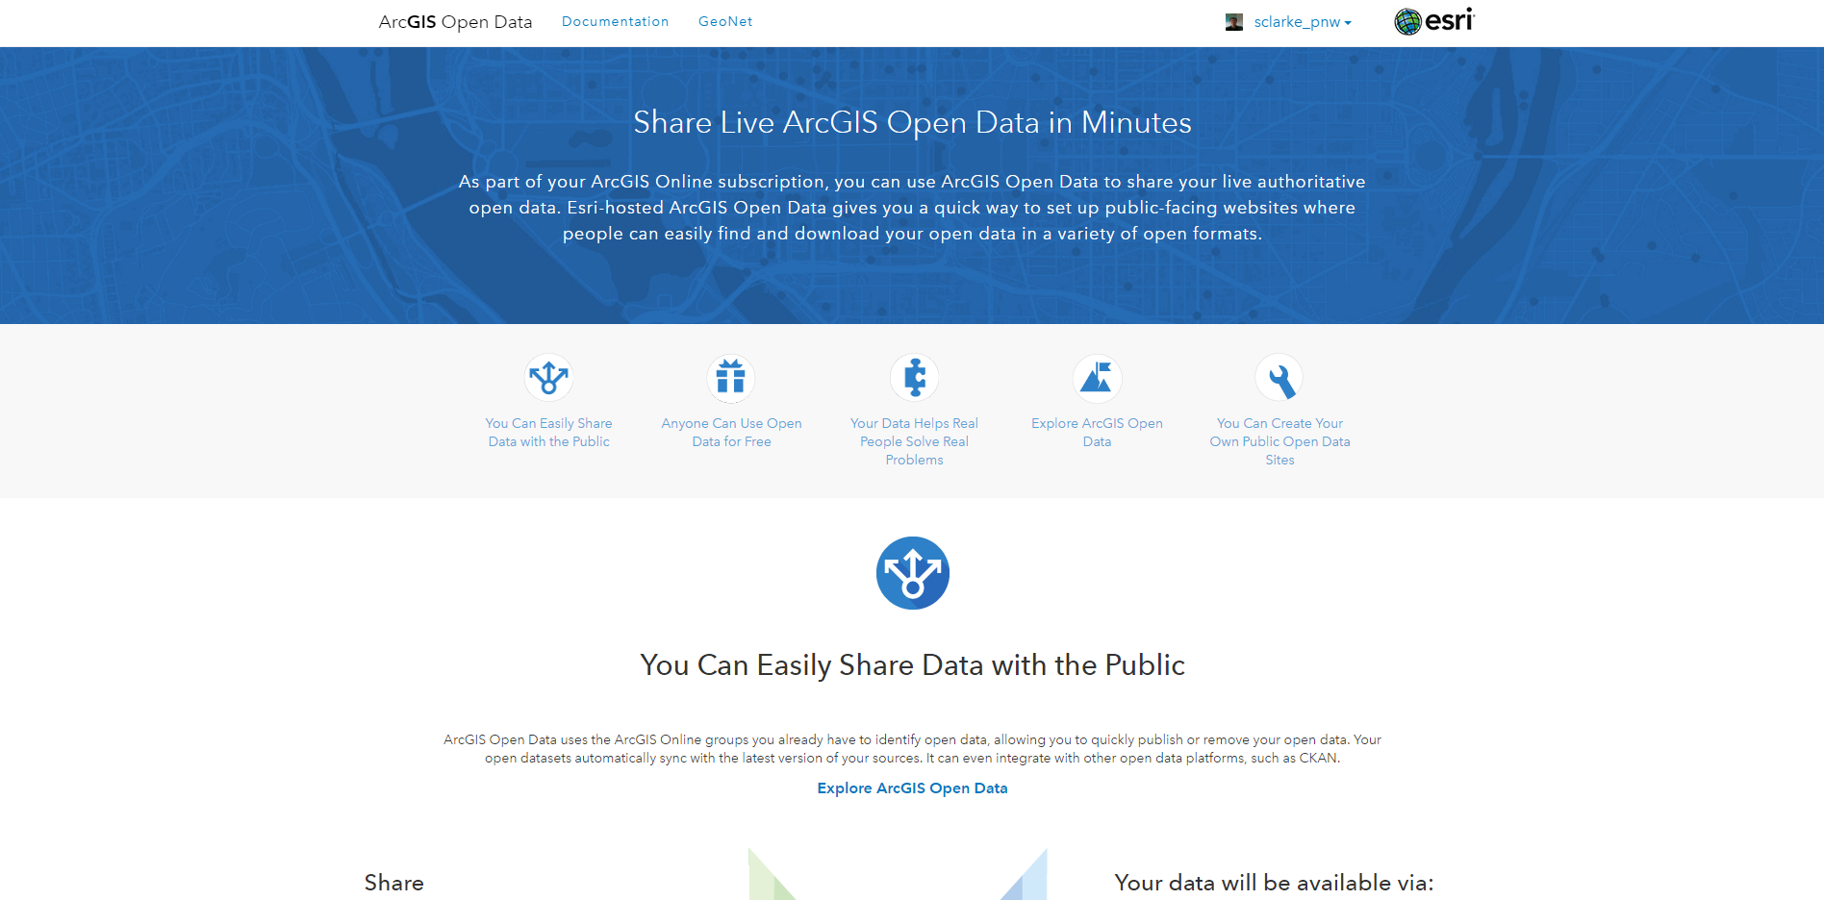
Notes:
This slide could be used as an alternative to use the web site to go through the features of ArcGIS Open Data.
[Use https://hub.arcgis.com/pages/open-data to talk through the features of ArcGIS Open Data.]

Slide 11
ArcGIS Open Data is part of the ArcGIS Platform
Providing open access to your published data
Desktop
Web
Device
Apps
Simple
Integrated
Open
Web GIS
Portal
Open Data Site
Access
Services
Server
Online Content and Services
Notes:
Firstly, the ArcGIS Open Data app is part of the ArcGIS Platform, and is available to every Online organization as part of your subscription for no extra cost.
ArcGIS Open Data allows you to create Open Data sites that are populated from the content from your organization, or other organizations that make open data available across the platform.

Slide 12
ArcGIS Open Data is accessible
Users can easily access the data they want
Users can connect with the data at the source
Users know the licensing information
Notes:
Connect with the data at the source – there is no requirement to store duplicate copies of your data. The ArcGIS Open Data app can use the primary, authoritative data source.

Slide 13
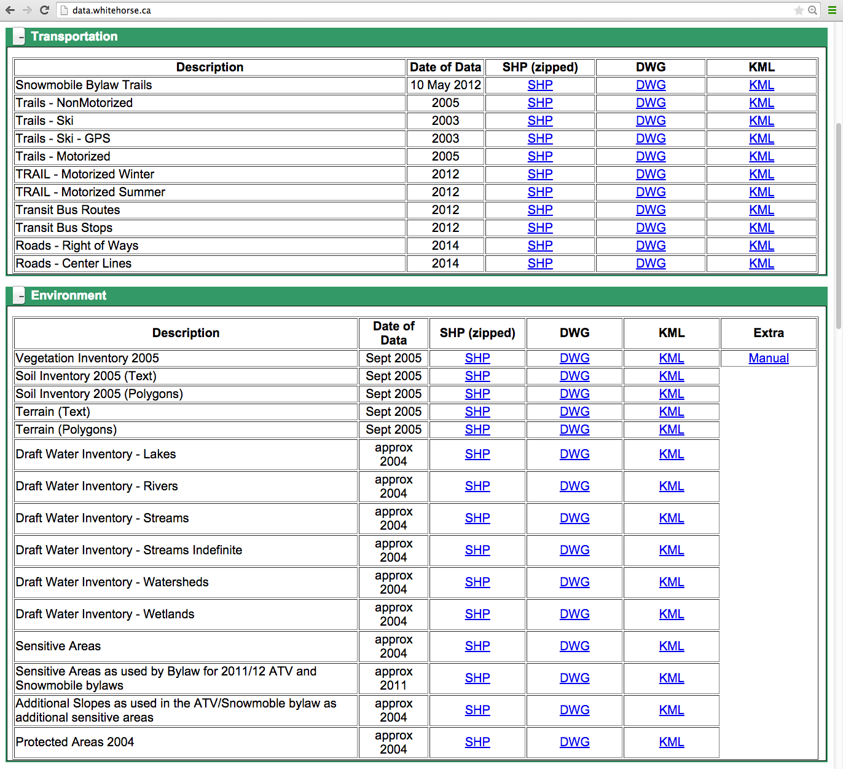
FTP websites
Notes:
Compare ArcGIS Open Data to the common FTP websites – which the GIS community has provided for years, long before the term “Open Data” was coined!
The disadvantages of FTP sites include:
Download of static, out-of-date data (i.e. does not connect with the data at the source)
Need some GIS knowledge to understand and work with the downloaded data

Slide 14
ArcGIS Open Data is discoverable
Users can view all datasets on a site
Users can search for specific datasets
Users can see suggested related datasets

Slide 15
ArcGIS Open Data is explorable
Users can filter and sort data
Users can search by location
Users can visualize data in different
smart mapping and chart options

Slide 16
ArcGIS Open Data is collaborative
Users can download data in multiple open formats
Spreadsheet (CSV)
KML
Shapefile
File Geodatabase
API access: GeoJSON, GeoService, OGC WMS
Users can share and embed datasets
Users can add data to ArcMap or ArcGIS Online
Data can be linked with CKAN & data.gov

Slide 17

Demonstration
Using ArcGIS Open Data Sites

Slide 18
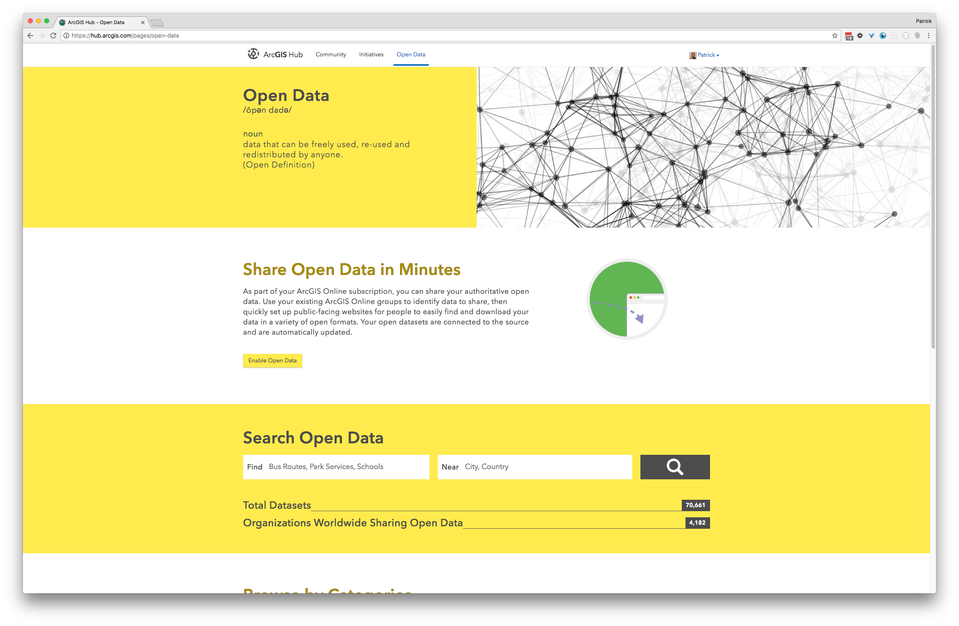
Notes:
[Screenshot taken 7/30/2017 https://hub.arcgis.com/pages/open-data]

Slide 19

Exercise 1: Explore ArcGIS Open Data sites

Slide 20
Exercise 1: Explore ArcGIS Open Data sites
Explore sites
Follow steps in the “For Consumers” section of the online documentation: https://doc.arcgis.com/en/hub/sites/find-data.htm
Discover data
View details
Download data
Explore data
Chart data
Visualize data
Sign in
Comment on data
Use the preview map
https://hub.arcgis.com/pages/open-data
http://accessoakland.oakgov.com/
http://dc.esri.com/
http://geohub.brampton.ca/
http://data-summitgis.opendata.arcgis.com/
http://datahub.johnscreekga.gov/

Slide 21
Data preparation and organization workflows
Notes:
Creating an ArcGIS Open Data site is relatively easy and quick. The time consuming aspect of a good Open Data site is preparing data so that it is well described and easily understandable.
So, data preparation is probably the most important, time consuming aspect of creating and maintaining a good Open Data site.

Slide 22
Preparing your data
Make the data easy to understand
Set attribute aliases
Less than ten characters
Set an appropriate hover field
Hide attributes that don’t add meaning
Keep Object ID and Shape fields
Online Doc has good section on “Improving data quality”
https://doc.arcgis.com/en/hub/data/prepare-your-data.htm
Notes:
Hover field – specify “Display field” in ArcMap.
Ten character field limit is due to shapefile option download

Slide 23
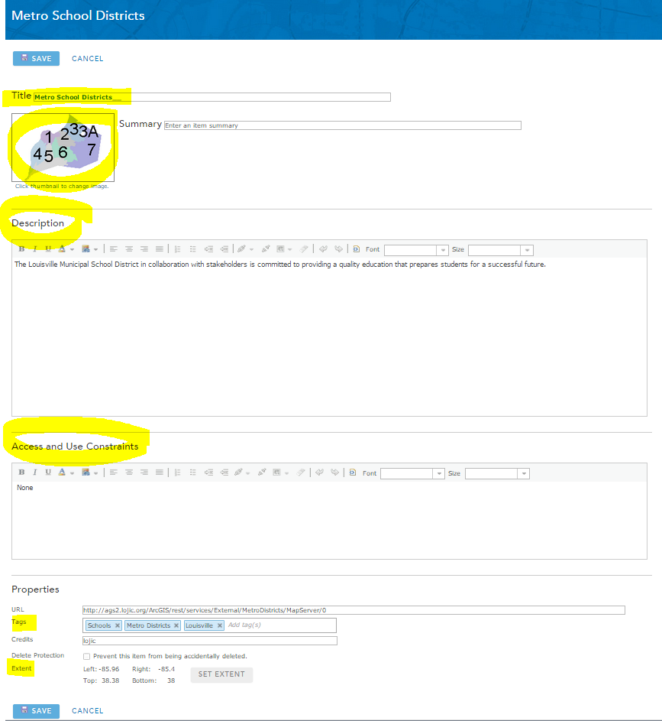
Critical Item Details

Slide 24
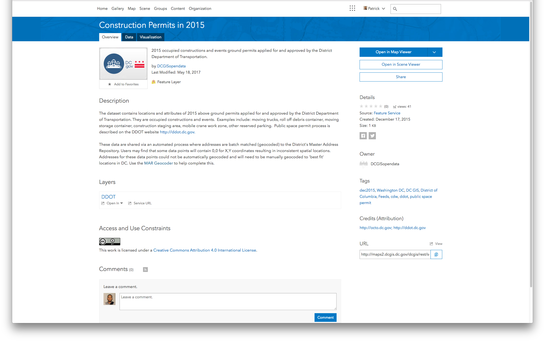
Notes:
Make sure to complete the “Access and Use Constraints” – this is what is used in the Licensing field for Open Data.
https://doc.arcgis.com/en/hub/data/prepare-your-data.htm (creative commons licensing)

Slide 25
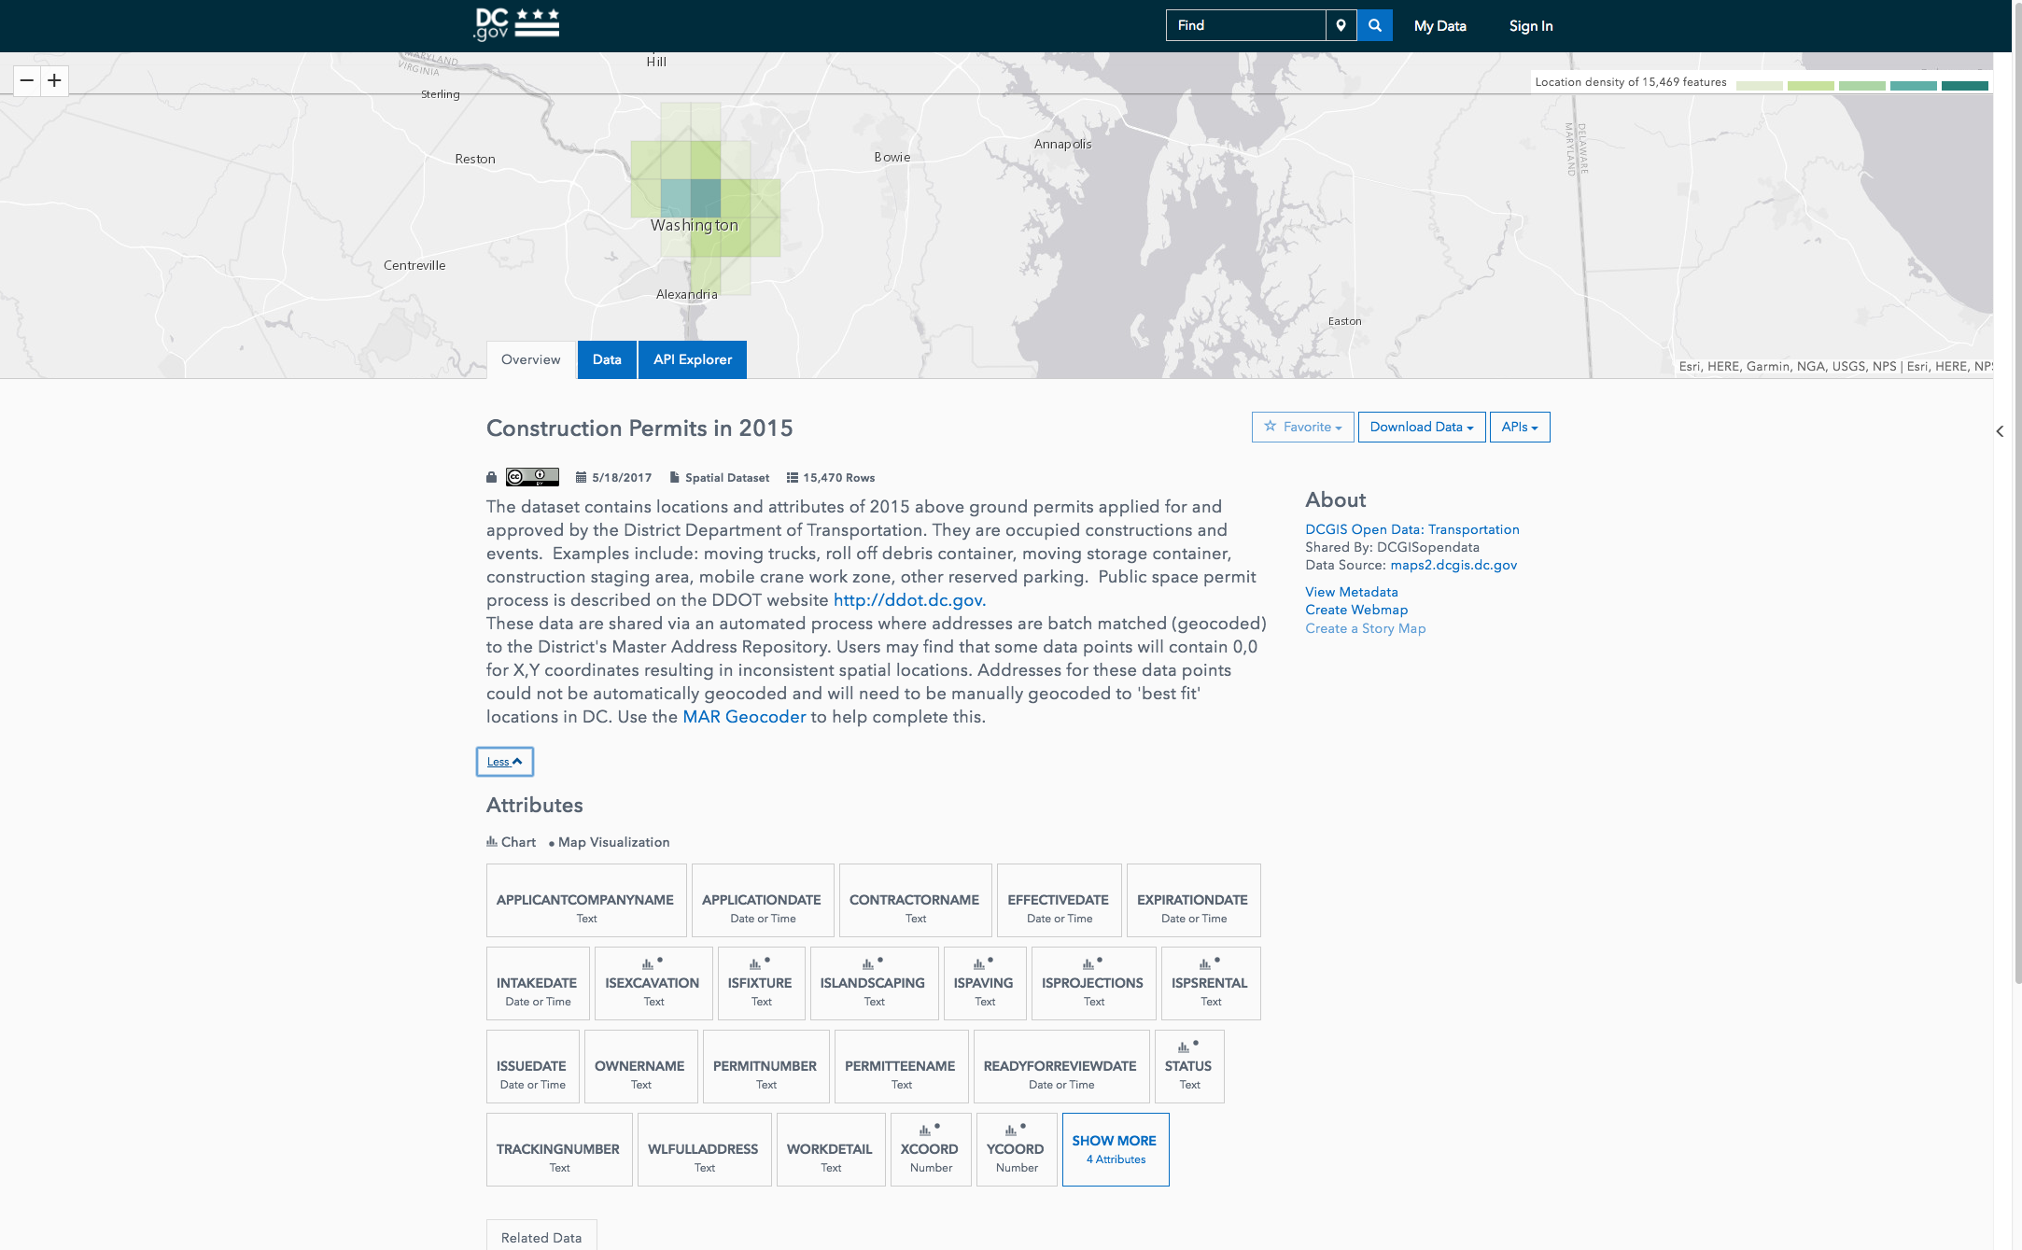
Notes:
http://opendata.dc.gov/datasets/construction-permits-in-2015

Slide 26
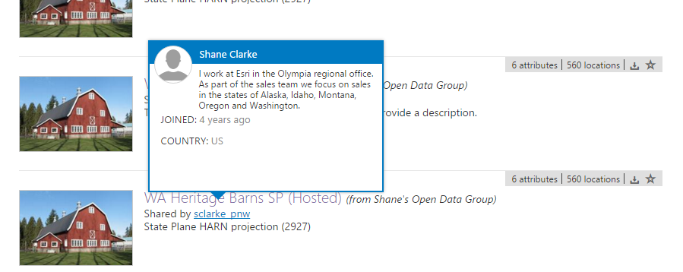
Use an Authoritative ArcGIS Online Profile
Profile name should convey authoritative source
Profile description and photo needs to be
Professional
Informative
Authoritative
Include contact information

Slide 27
Add items to ArcGIS Online
Leverage workflows you know
Catalog all your data in ArcGIS Online
Upload local items from the web or ArcGIS Desktop
Register services from ArcGIS Server
Open Data supports different file types:
Map services
Feature services
Image services
CSVs
PDFs and Word docs
URLs (e.g. for web apps)
Web Maps
Notes:
Leverage workflows you know – i.e. using the same workflows of publishing services, and sharing them via ArcGIS Online.
PDFs, Word docs, URLs, and Web Maps do not have their own dataset page. These will open in a new tab, or download (Word doc).

Slide 28
Registering services to ArcGIS Online
Registering services with multiple layers
Quicker
Less control over search results and item’s metadata
All layers will have same tag, thumbnail
Registering individual layers
More time consuming
Better search results and item’s metadata
Recommended method
Sample python script to register service layers individually
https://github.com/hamhands/arcgis-api-samples/blob/master/bulk_service_registration.ipynb

Slide 29
Create effective metadata
Metadata helps make your data more authoritative and provides context
Titles
Description
Licensing
Tags
Icons
Add official metadata files to ArcGIS Online item
https://doc.arcgis.com/en/arcgis-online/share-maps/metadata.htm
Notes:
More detail to be covered in Advanced Topics.

Slide 30
Persistent linkages
Update your data in one place
Automatic updates across all sites
Users get authoritative and timely data

Slide 31
Demonstration
Preparing and organizing data for ArcGIS Open Data
Notes:
Show :
1. Creating hosted service from ArcMap
2. Creating hosted service from ArcGIS Online
3. Registering ArcGIS Service / add item from the web

Slide 32
Exercise 2: Create content for ArcGIS Open Data

Slide 33
Exercise 2: Create content for ArcGIS Open Data
Use http://njtpa.maps.arcgis.com
Publish hosted feature layers (services)
Use ArcGIS Desktop or ArcGIS Online
Datasets:
Jersey Devil Sightings
Cemeteries
Reference ArcGIS Server services
Find ArcGIS Server REST endpoint (URL)
Add items from the web http://doc.arcgis.com/en/arcgis-online/share-maps/add-items.htm
Dataset:
https://geodata.state.nj.us/arcgis/rest/services/Features/Land_Use_and_Land_Cover/MapServer/7
Share items to public
Share items to “NJTPA Open Data Workshop” group
Notes:
GOAL – get each person to add one item/layer to the open data group.
[Need to add the following to this exercise:
Publish services via ArcGIS Pro
Adding real metadata]

Slide 34
Demonstration
Creating Open Data Sites + Pages

Slide 35
Resources
ArcGIS Open Data help documentation
http://doc.arcgis.com/en/hub/get-started/enable-open-data-capabilities.htm
Customization Demo Page
http://deepcustom-andrew.opendata.arcgis.com/
ArcGIS Blog
GeoNet
Share ideas, questions, experiences with the community

Slide 36
Thank you!
phammons@esri.com

Slide 37
Creating an Open Data site

Slide 38
Creating an Open Data Site
Enable the Online Organization
Designate Groups for Open Data
Create authoritative content
Prepare spatial and non-spatial data
Create custom role
Enable staff in other departments
Create an Open Data Site

Slide 39
Turn on Open Data
Enable Open Data for your ArcGIS Organization
In your ArcGIS Online organization settings
Set user roles as desired
Does not mean all data is publicly accessible
Optionally, enable metadata for the organization
In your ArcGIS Online organization settings

Slide 40
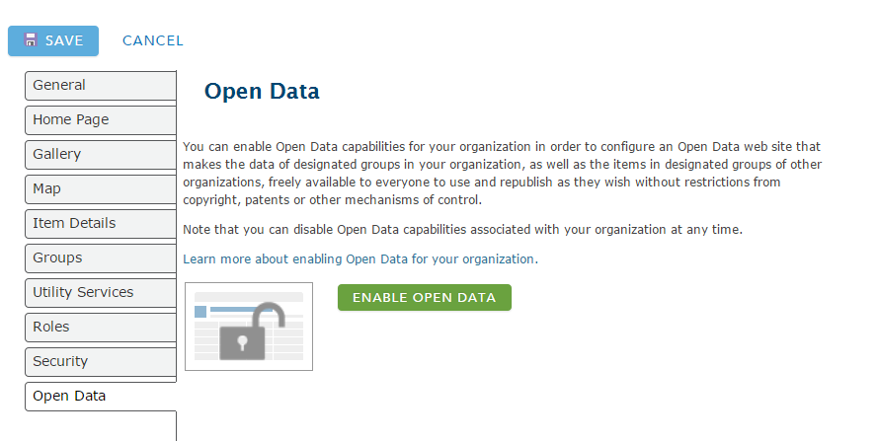
Enable Open Data for Organization

Slide 41
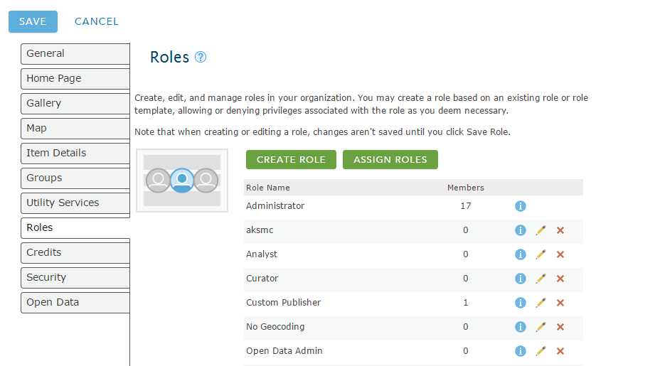
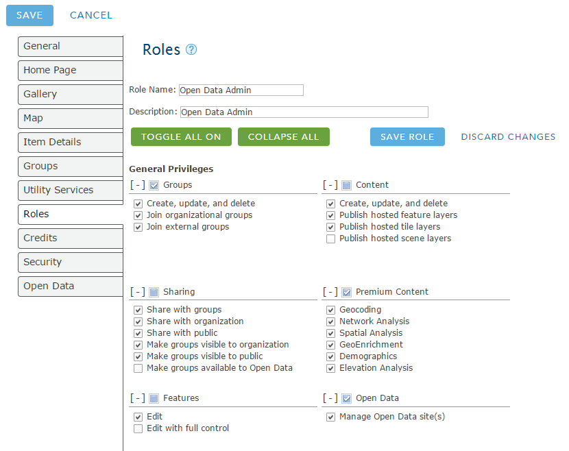
Create Custom Role(s)

Slide 42
Specify Open Data groups
Control what content appears on your Open Data site
Create or edit groups to organize Open Data content
One large Open Data group
Smaller thematic Open Data groups
Enables thematic group search
e.g. https://hifld-dhs-gii.opendata.arcgis.com/
Set groups to public and designate as Open Data
Share items to your Open Data groups
Can add open data groups from other orgs (federation)

Slide 43
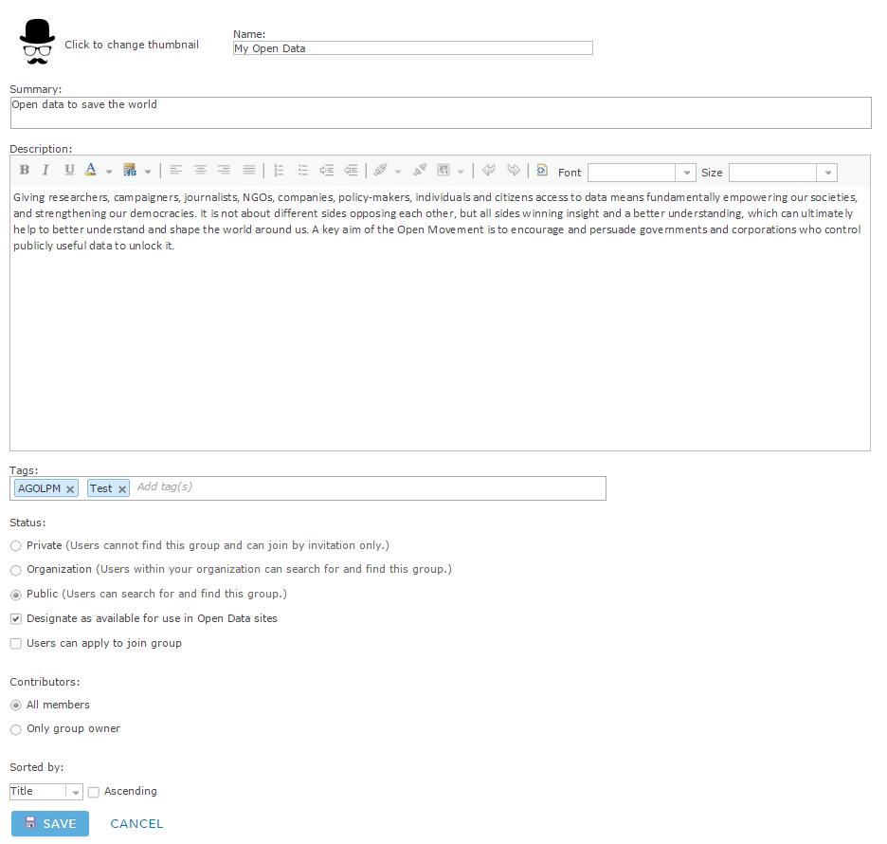
Designate Open Data Groups

Slide 44
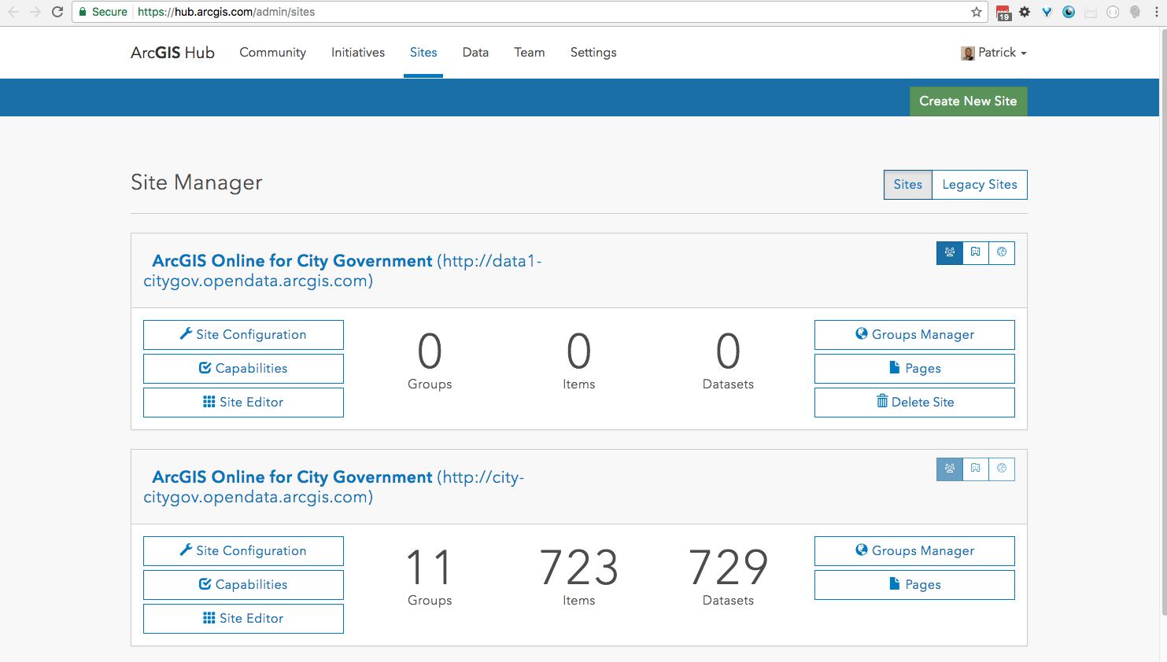
Create new Open Data site

Slide 45
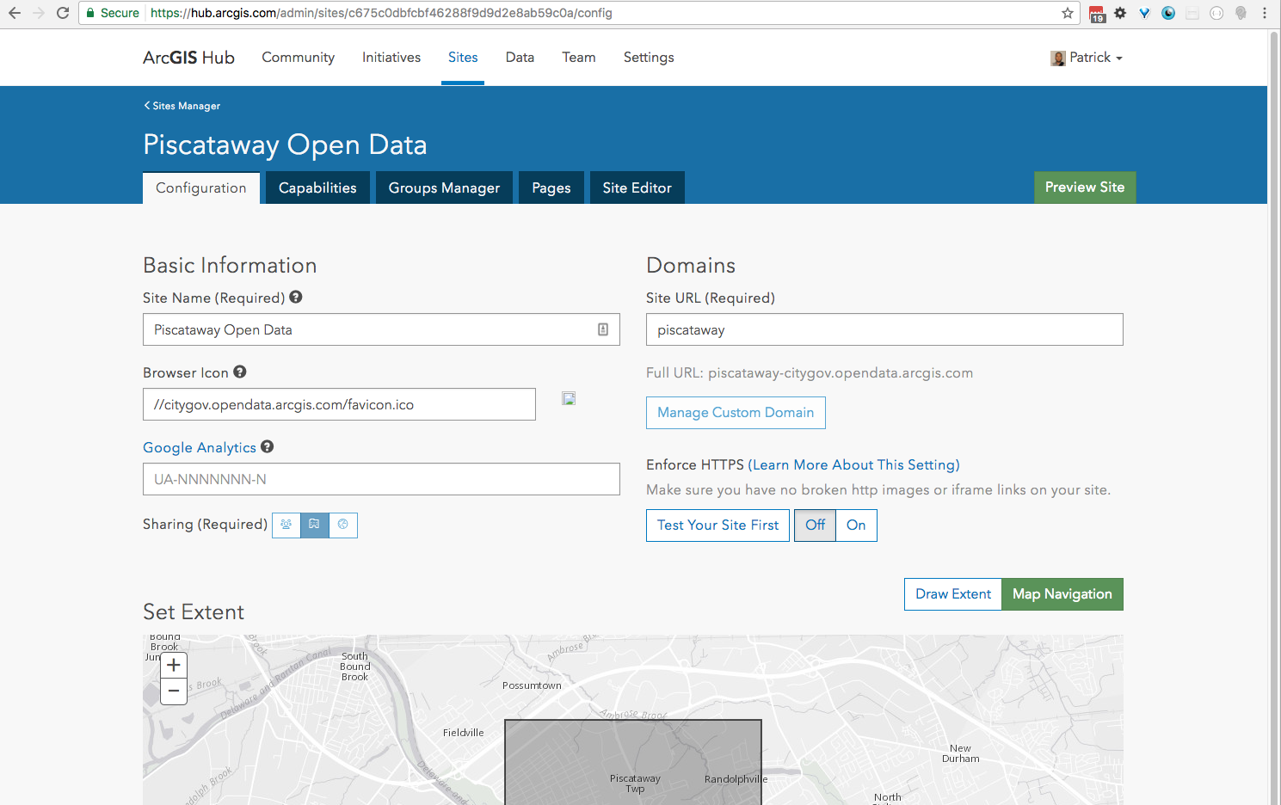
Configuring your Open Data site
Setting basic information
Set title
Site URL
[name].[yourorg].opendata.arcgis.com
Custom URL
Map extent
Public or private

Slide 46
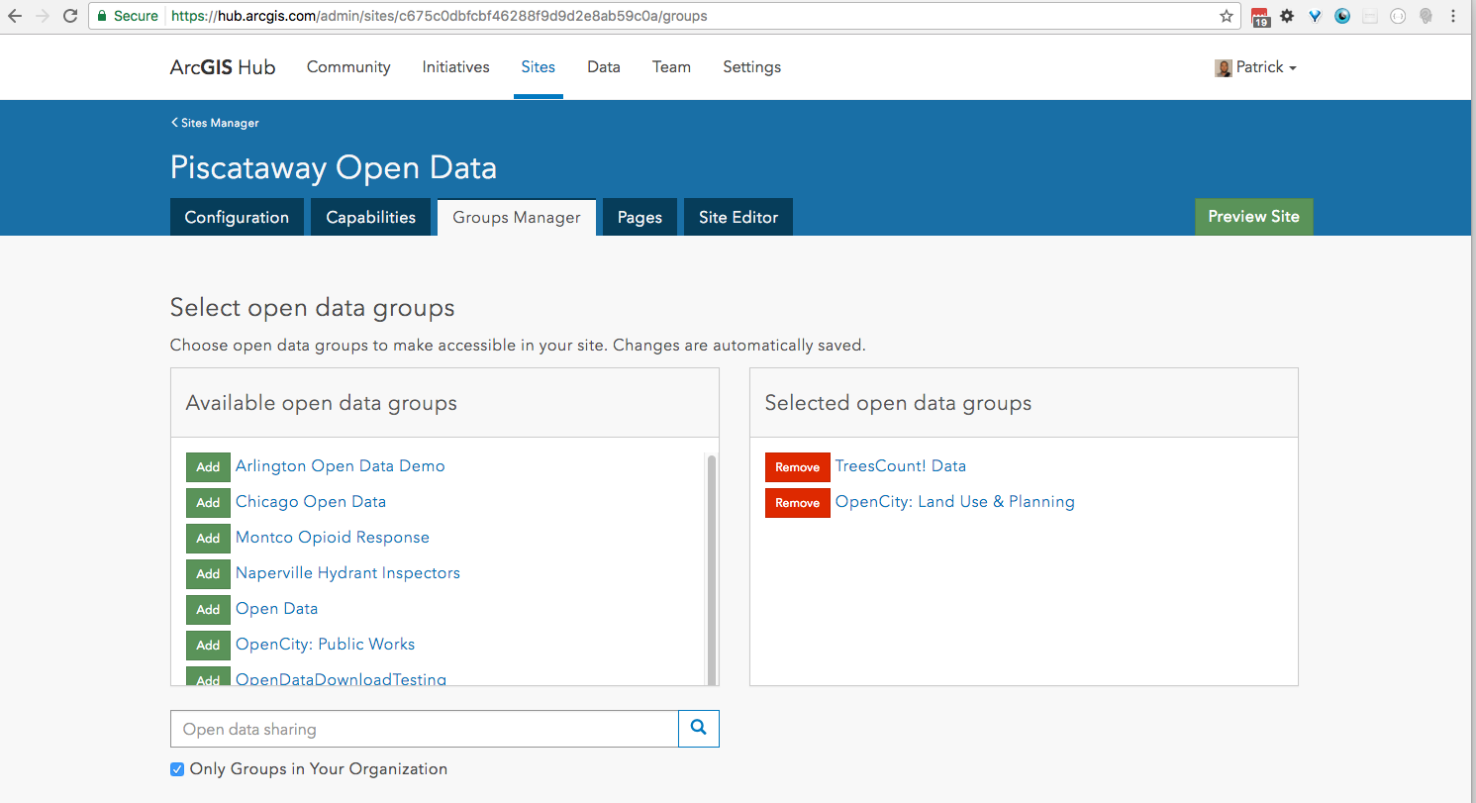
Adding your data
Manage data and review status
Search Open Data groups
Add groups from your org
Add groups from other orgs
Review harvesting status

Slide 47
Designing your site layout
Design layout
Use the WYSIWYG Editor
Content Cards
Row - Banner - Category (tags, groups) - Summary Statistics
Image - Text - Charts - Iframe
Use custom HTML/CSS
Site Header
Within cards

Slide 48
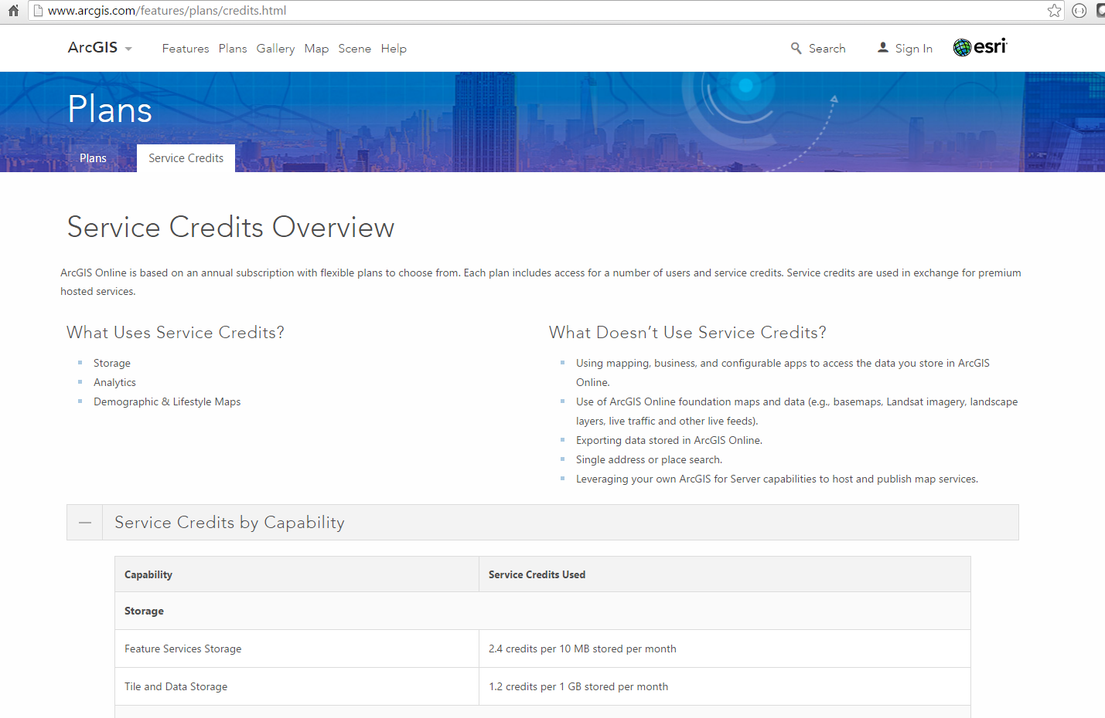
ArcGIS Online Service Credits
Notes:
Address the question: “Does ArcGIS Open Data use credits?”
Only for storage. No credits used for anything else. No credits used for viewing, download, etc.

Slide 49
Demonstration
Creating an ArcGIS Open Data Site

Slide 50
Exercise 3: Create an ArcGIS Open Data site

Slide 51
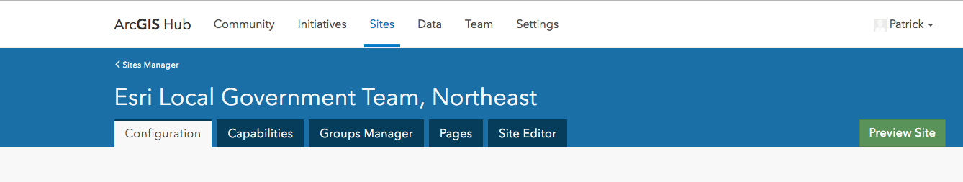
Exercise 3: Create an ArcGIS Open Data site
Use http://localgovne.maps.arcgis.com/
Create and configure an Open Data Site
https://doc.arcgis.com/en/hub/sites/create-an-open-data-site.htm
Manage Site Capabilities
Explore
Groups Manager
Data Manager
Site Editor

Slide 52
Customizing the Open Data site

Slide 53
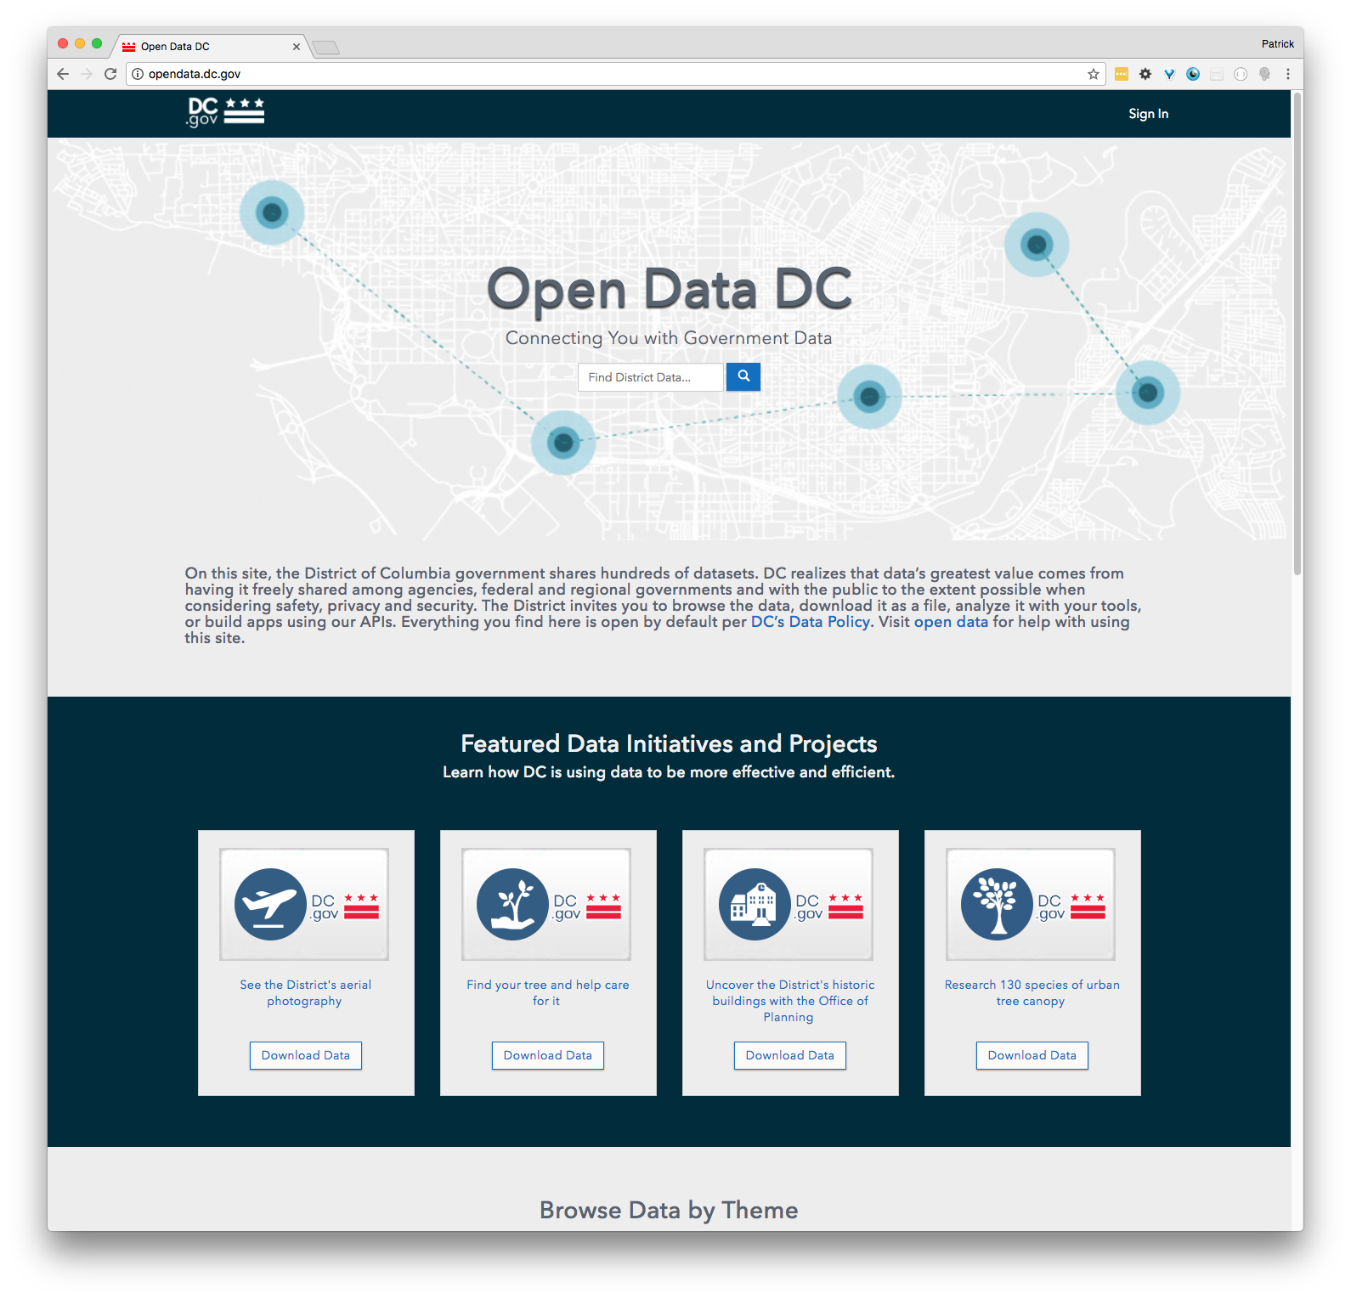
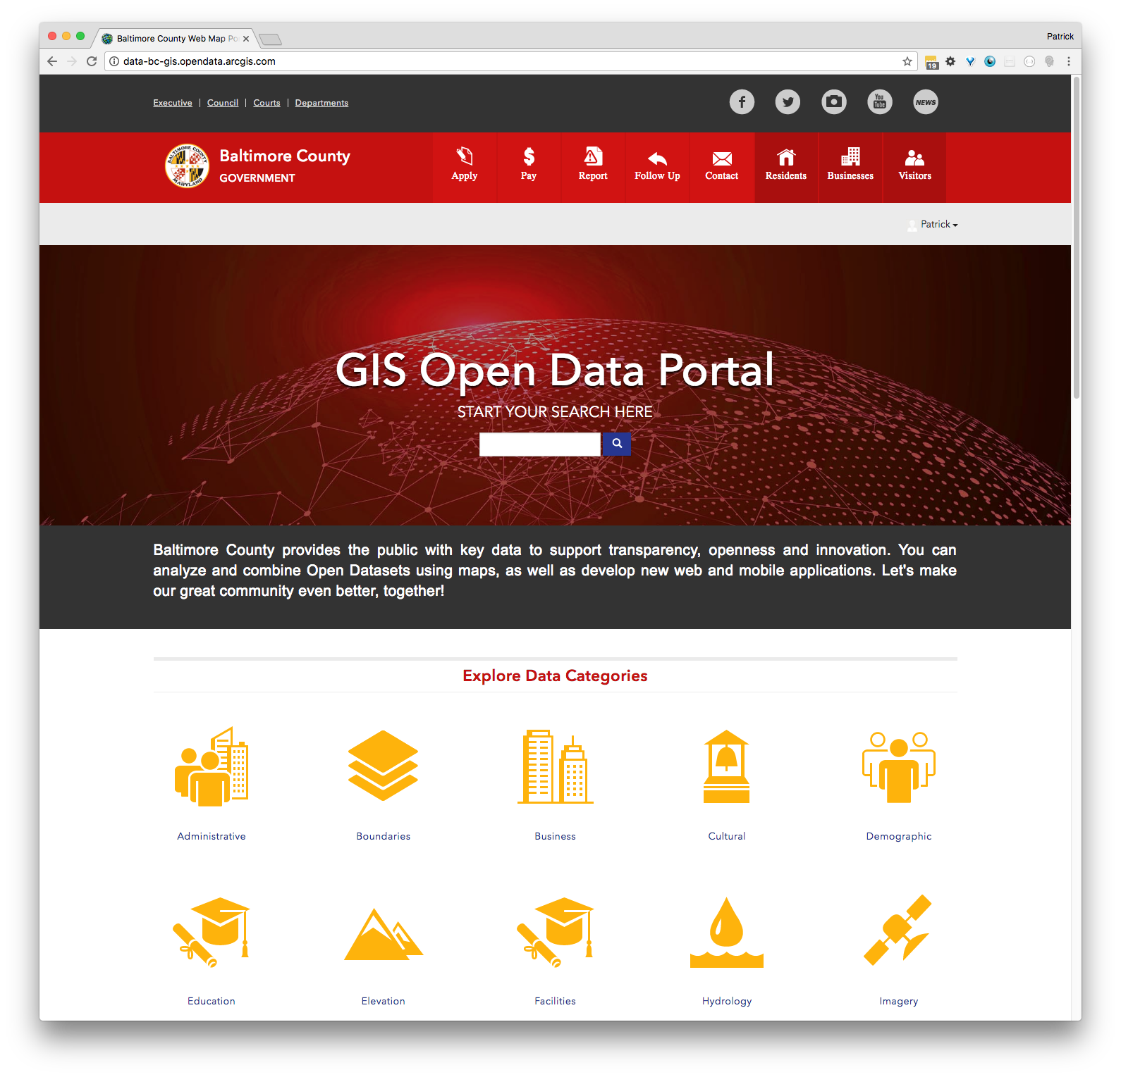
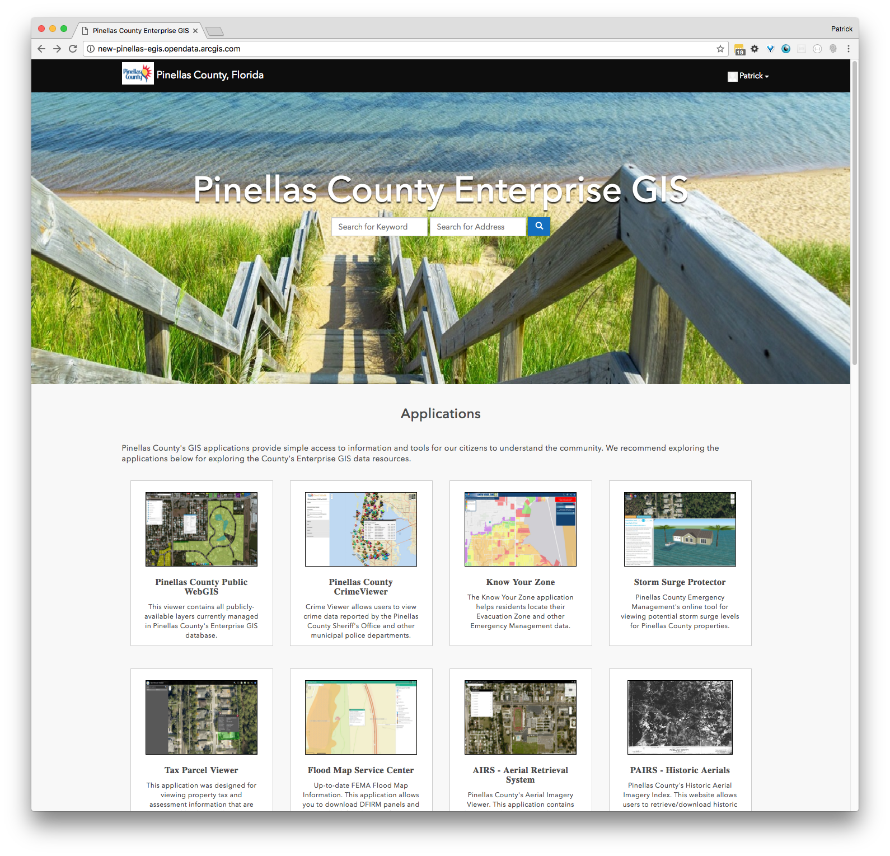
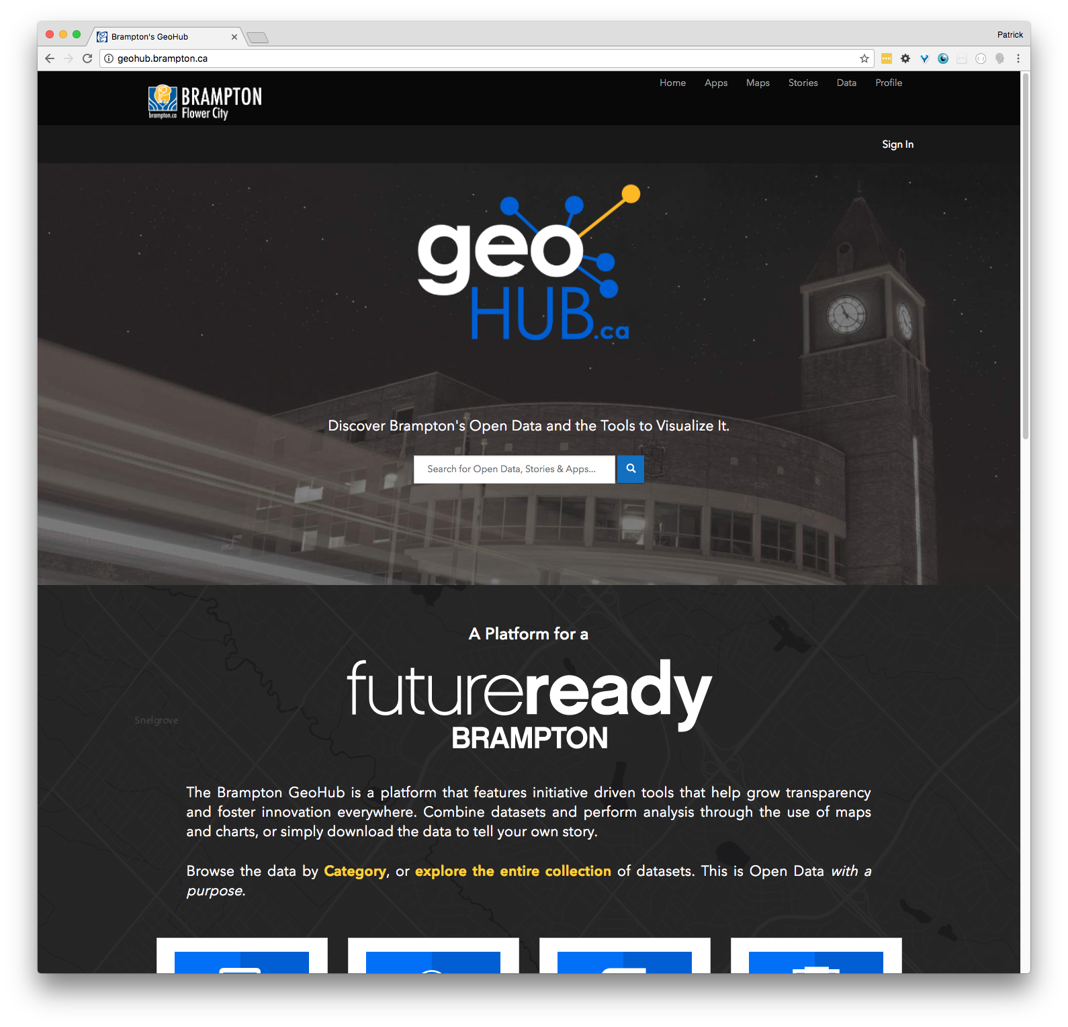
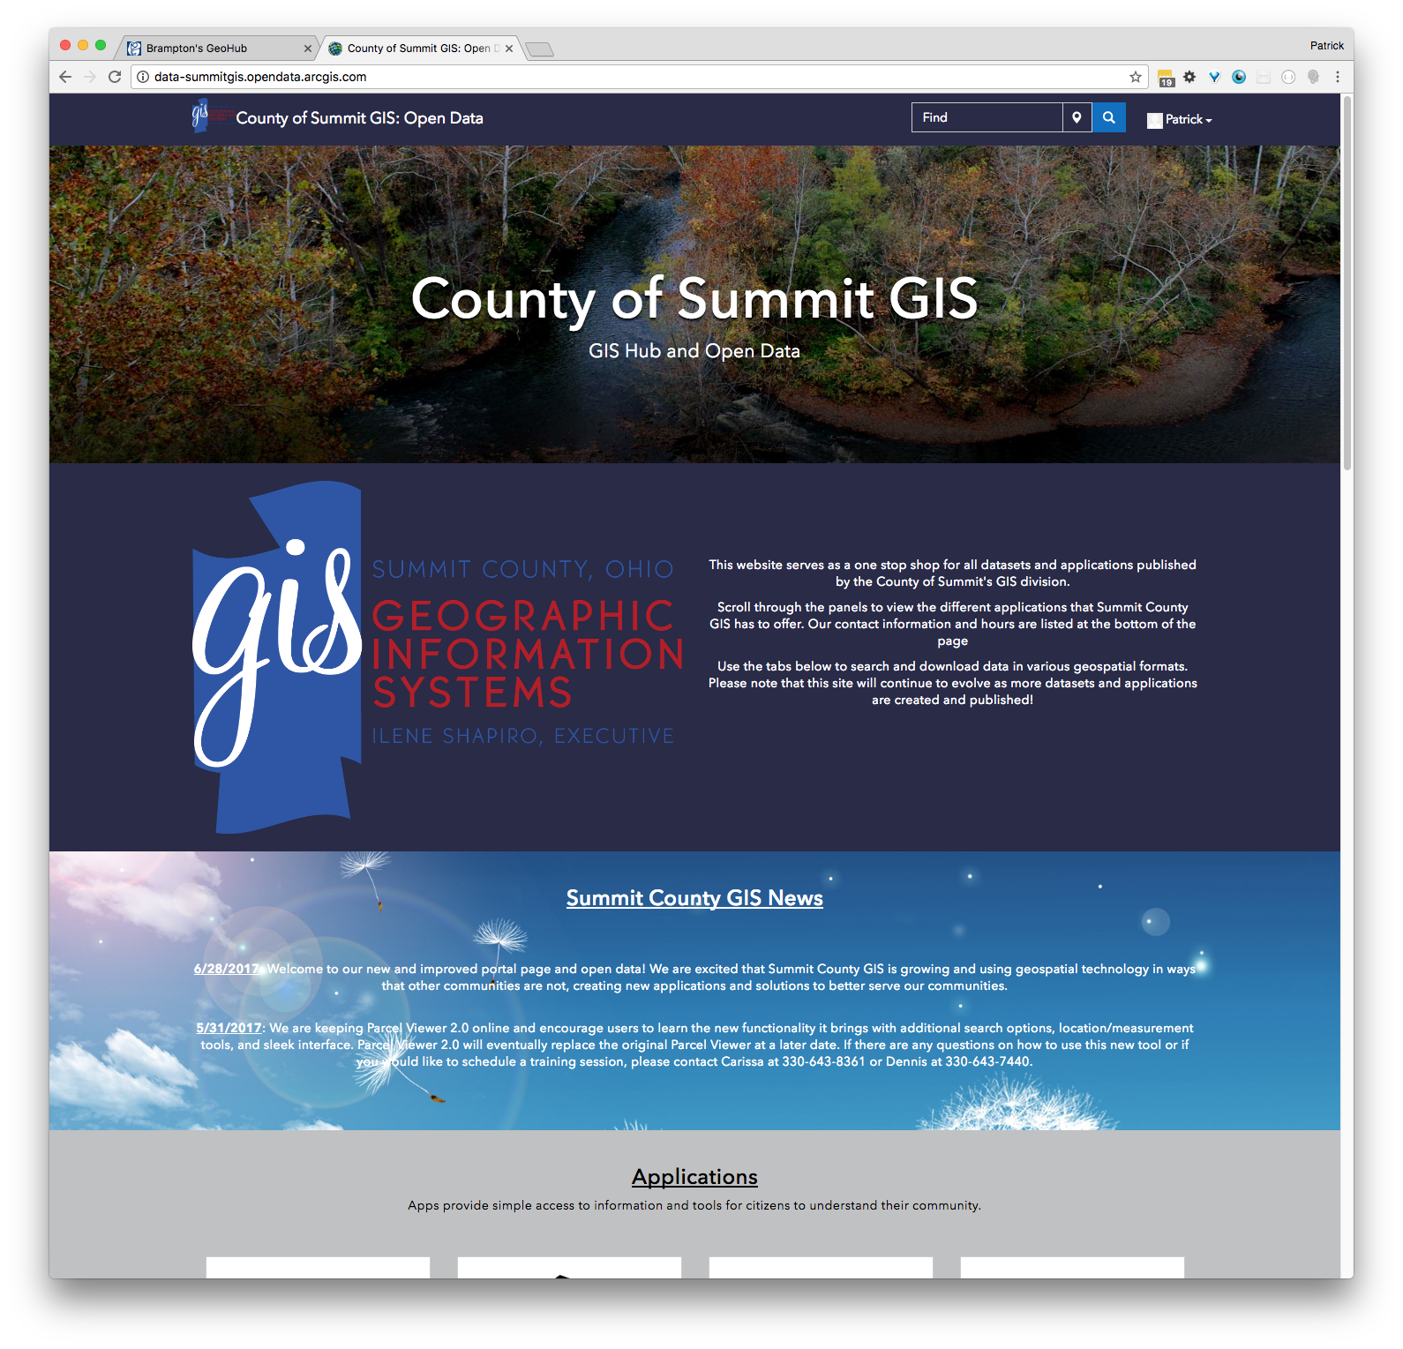
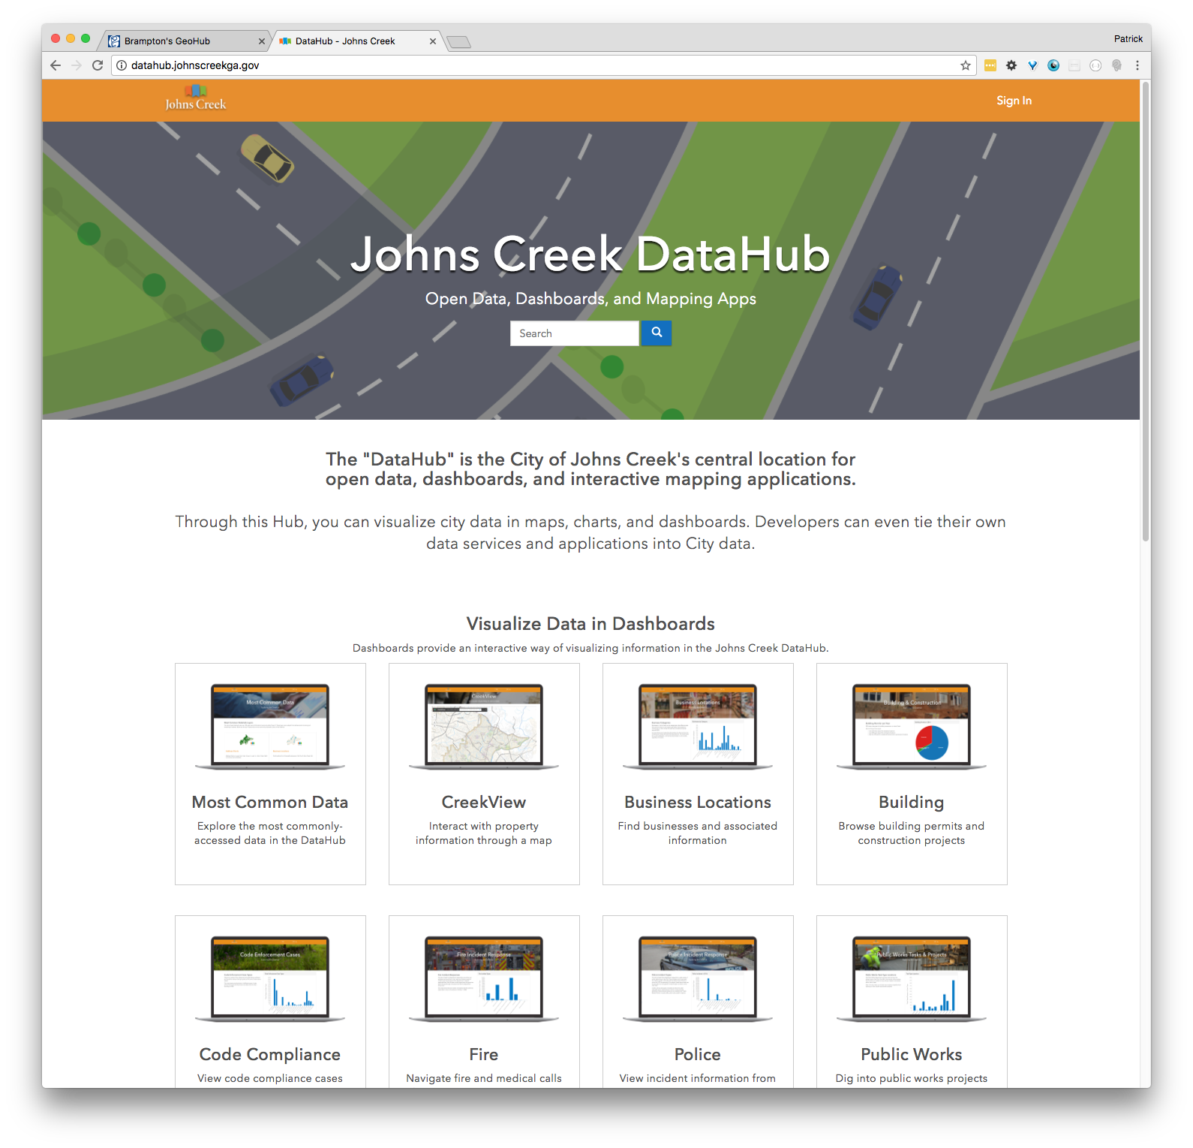
Notes:
There are a lot of options to build great-looking open data sites.

Slide 54
Customizing the Site Layout
Site Editor tab
WYSIWYG Interface
Site Header – Logo + Site Title or custom HTML/CSS
Theme Builder – Background + Text Colors
Layout Builder – Content Cards
Footer Settings – None (default) or Custom
Content Cards
Text, Images, Banners
Charts, Statistics, Iframes
Datasets, Apps, Categories
https://doc.arcgis.com/en/hub/sites/design-the-layout-of-your-open-data-site.htm

Slide 55
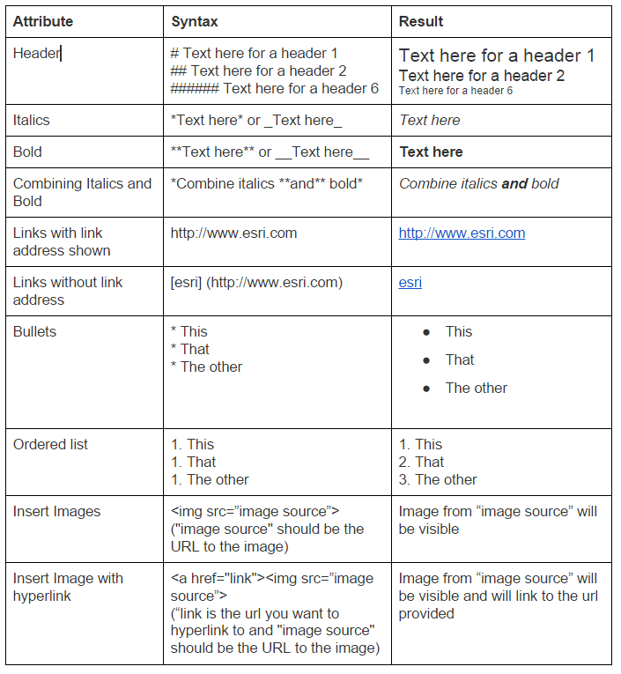
Using Markdown
Markdown is used in content cards
Markdown Basics
http://daringfireball.net/projects/markdown/basics
HTML/CSS also supported

Slide 56
Grouping Data
Thematic tags to direct users to specific datasets
Add search options to the site URL
Full Search: http://talgov.tlcgis.opendata.arcgis.com/datasets?q=business
Tag Search: http://opendata.dc.gov/datasets?keyword=education
Group Search: https://hifld-dhs-gii.opendata.arcgis.com/datasets?group_id=c9584c01b4564b188b98d3ef9cf3e57c
Use Category Card
Tag or Group
Provided icons or URL for custom icons
Attach link to text, (text widget) using markdown
[Education](http://opendata.dc.gov/datasets?keyword=education)
e.g. http://opendata.dc.gov
Attach link to image, (image widget) using markdown
Specify Image Source URL and Image Link
e.g. http://vicroadsopendata.vicroadsmaps.opendata.arcgis.com/

Slide 57
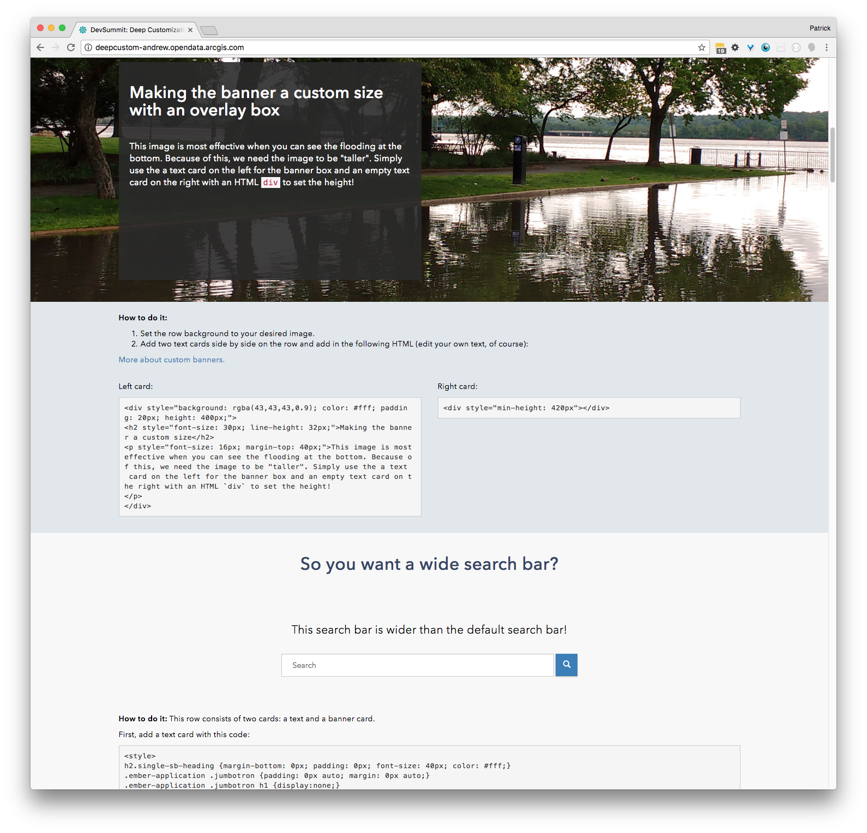
Deep Customization
Enhanced navigation
Banner formatting
Search bar sizing
Styling text cards
Utilizing blank rows and text cards
Tables
http://deepcustom-andrew.opendata.arcgis.com/
Notes:
Original URLs:
Brookline (http://data.brooklinema.gov/ )
Header Button: https://gist.github.com/FelFly/3a3ea8b3a01e1fde67e2
Grid: https://gist.github.com/FelFly/71539abc8d16f9f0caff
Charlotte (http://clt.charlotte.opendata.arcgis.com/ )
CSS: https://gist.github.com/FelFly/f150fc05fd7c62e98ced
California Dept. of Public Health
CSS: https://gist.github.com/FelFly/7dde80288d05b945d5c9
Body: https://gist.github.com/FelFly/80cc129feb8f48386a5d
Footer: https://gist.github.com/FelFly/c73d6ddf07fea7fa2b21
Detroit (https://data.detroitmi.gov/ )
Footer/Header/CSS: https://gist.github.com/FelFly/3a677a84a5209d08667a

Slide 58
Demonstration
Customizing the ArcGIS Open Data Site

Slide 59
Exercise 4: Customize your ArcGIS Open data site

Slide 60
Exercise 4: Customize your ArcGIS Open data site
Use http://localgovne.maps.arcgis.com/
Open Site Editor
Design the layout of your Open Data site
https://doc.arcgis.com/en/hub/sites/design-the-layout-of-your-open-data-site.htm
Choose colors and set background/text in Theme Builder
https://coolors.co/app
Add content cards
Try some customizations

Slide 61
Promoting your Open Data site

Slide 62
Engaging your community
Make your Open Data site public
Keep your Open Data site fresh (new datasets, highlighted datasets, design)
Use a custom URL
Link to open data from apps
Start a two-way conversation
Set up a twitter account or blog
Speak at local seminars or conferences
Connect to the local data community
Civic hacking groups
Host events
Hackathons
Contests
Showcase how people are using your data

Slide 63
Advanced Topics

Slide 64
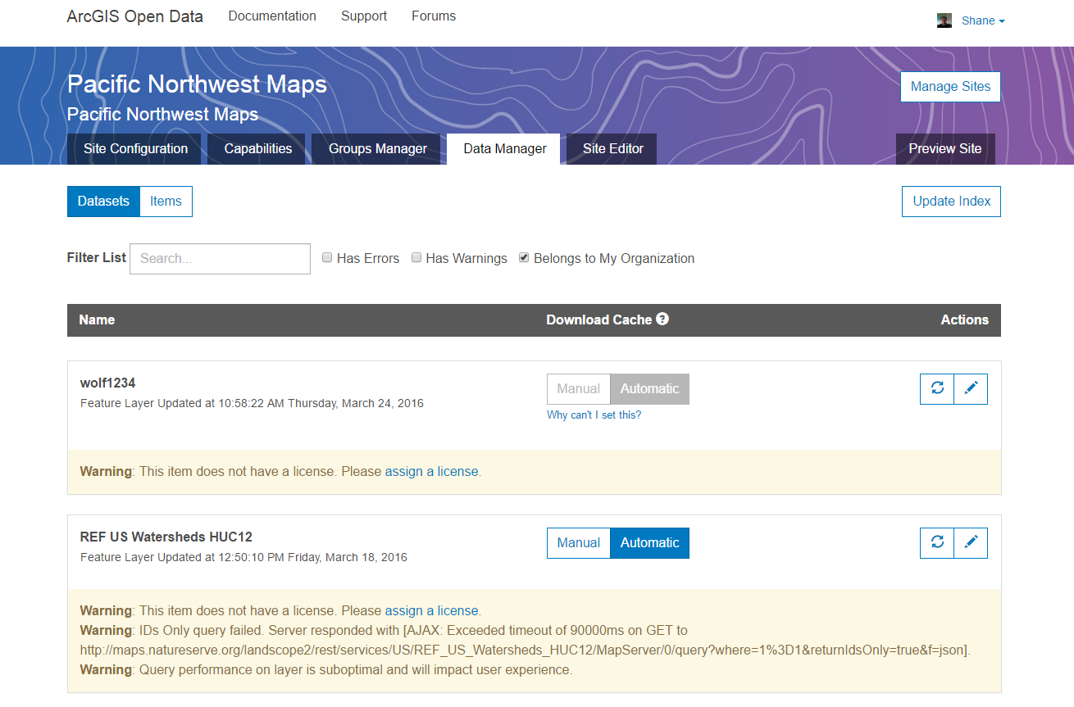
Open Data Site Administration
Notes:
Administer your Open Data Site through the Data Manager tab, in the open data site builder admin website.

Slide 65
Data Manager
Identify issues, manage caching, resync data
Warnings
Successfully indexed, but with issues
Missing license - “Access and Use Constraints” in the item details is empty
Solution – fix item detail, or register individual service layers
Errors
Failed to index
ArcGIS Open Data cannot access dataset (firewall, server down, item not supported)
Solution – remove item from Open Data group
Manual reset
Refreshes the download cache
http://doc.arcgis.com/en/open-data/provider/data-manager.htm

Slide 66
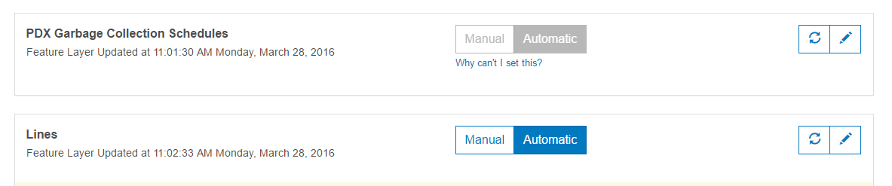
Caching
Set in Data Manager
Caching
Dynamic copy of the data in the cloud
Improves download times, takes load off local servers
PDFs, docs, URLS, and web maps not cached
Manual or Automatic cache updates
Automatic cache updates
Setting for all hosted services
Cache dropped every 24 hours and regenerated with next download request
Recommended for data sets with frequent updates (e.g. crime)
Manual cache update
Only updated when administrator manually resets data
Recommended for large data sets with infrequent updates (e.g. parcels)

Slide 67
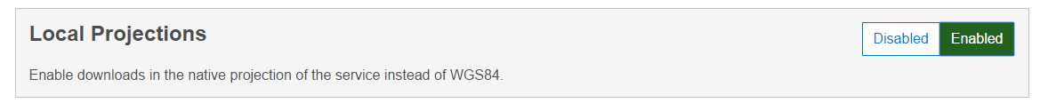
Projections
By default, all services will download in WGS84
Option to Enable Local Projections (in Site Capabilities)
All services in ArcGIS for Server downloaded in original projection
All feature services hosted in ArcGIS Online downloaded in original projection
Creating services from shapefiles and CSV files
Hosted services created in ArcGIS Online created in WGS84 projection
Use ArcGIS for Desktop to created hosted service in non-WGS84 projection

Slide 68
Server Configuration Details – Service Properties
ArcGIS Open Data supports services on ArcGIS Server 10.0 or higher
Max record count
Max record count is the maximum number of records per single request
Should be less than 5,000
Default is 1,000 for optimal performance
Only increase max record count if between 2,000 and 4,000 records in dataset
Services with max record count > 5,000 will receive warning in Data Manager
Services with max record count > 10,000 will not be indexed, error reported
Max record count does not impact downloads – all records downloaded
OCG links (in API section) come from ArcGIS Server, if enabled
Feature access not necessary (best to not enable)
Scale dependencies do not matter
http://doc.arcgis.com/en/open-data/provider/server-configuration-details.htm

Slide 69
Server Configuration Details – Organizing Services
Large services will time out
Organize data in multiple services, with less 20 layers per service
Services need to be publicly accessible
Extend your infrastructure to the cloud / ArcGIS Online
Reduces load on local servers
99.9% uptime for ArcGIS Online
Enable persistent layer ordering in service (ArcGIS Server 10.3 or higher)
Desktop Data Frame Properties > General > Allow assignment of unique IDs for map service publishing
Raster data is supported as Image Services
Download in supported formats: JPEG, PNG, georeferenced TIFF
Use SSL for services, if possible
http://doc.arcgis.com/en/open-data/provider/server-configuration-details.htm

Slide 70
Server Configuration Details – Managing the data
Change field names with aliases
Turn off unimportant fields
Geodatabase behaviors are not supported
Topologies, relationships, related tables – not supported
Coded value domains are supported
Data must support statistics
Requires ArcGIS Server 10.03 or higher
ArcGIS Open Data only builds statistics for first 20 columns in a dataset
CSV files under 5MB are dynamic
Use Publish as a Service for CSV files larger than 5MB
Enable editor tracking for accurate last updated date
http://doc.arcgis.com/en/open-data/provider/server-configuration-details.htm

Slide 71
Server Configuration Details – Item configuration
ArcGIS Online Item title is the dataset name
Access and Use Constraints is the data license
The license is important for data consumers
License can be a URL for existing data policies
License can be HTML code from Creative Commons License Picker
https://creativecommons.org/choose/
Search for data is based on the ArcGIS Online item extent (can be changed)
http://doc.arcgis.com/en/open-data/provider/server-configuration-details.htm

Slide 72
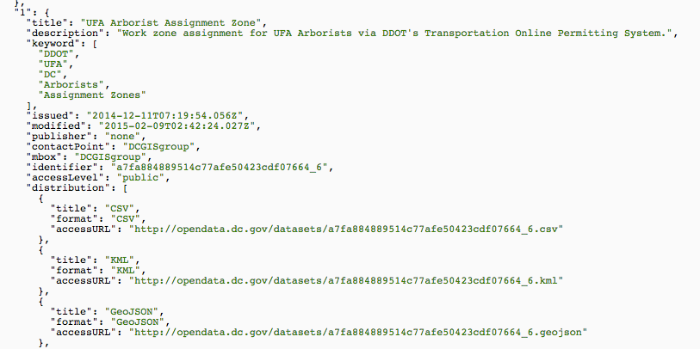
Integrating ArcGIS Open Data with other Open Data Platforms
Provide ArcGIS Open Data catalog to other Open Data platforms
DCAT format (JSON)
Append /data.json to Open Data site home page URL
One URL = hundreds of datasets
Used by http://www.data.gov/

Slide 73
Federating with CKAN
CKAN – open source data portal platform
Configure CKAN
Install the CKAN Harvesting extension
Install the CKAN DCAT extension
The Harvester Gather_Consumer and Fetch_Consumer services must be running as background services
Harvest the ArcGIS Open Data catalog
Add your DCAT (http://yourOpenDataSite/data.json) as a harvest source
http://doc.arcgis.com/en/open-data/provider/federating-with-ckan.htm

Slide 74
How to get metadata from ArcGIS for Desktop into ArcGIS Online
Not all metadata is included when publishing items – need to add metadata
The ArcGIS Online web-based metadata editor uses the ArcGIS metadata format
Fields available for editing determined by style configured for the organization
Use the ArcGIS for Desktop geoprocessing XSLT Transformation tool to convert other metadata formats to the ArcGIS metadata format.
Use the ArcGIS for Desktop geoprocessing Upgrade Metadata tool to convert to the ArcGIS metadata format (e.g. FGDC_TO_ARCGIS)
https://doc.arcgis.com/en/arcgis-online/share-maps/metadata.htm
http://desktop.arcgis.com/en/arcmap/latest/tools/conversion-toolbox/xslt-transformation.htm

